Slide 1

What Can I Cook?
A smart food suggestion web application.
Developed by 24120018 & 24120014 B.sc AIML 2Year
Hemraj Milind Sonawane
Roll No.:- 24120014
Lucky Ashok Chaudhari
Roll No.:- 24120018
B.sc AIML 2Year

Slide 2

The Everyday Problem
"What can I make with what's in my kitchen?"

Slide 3

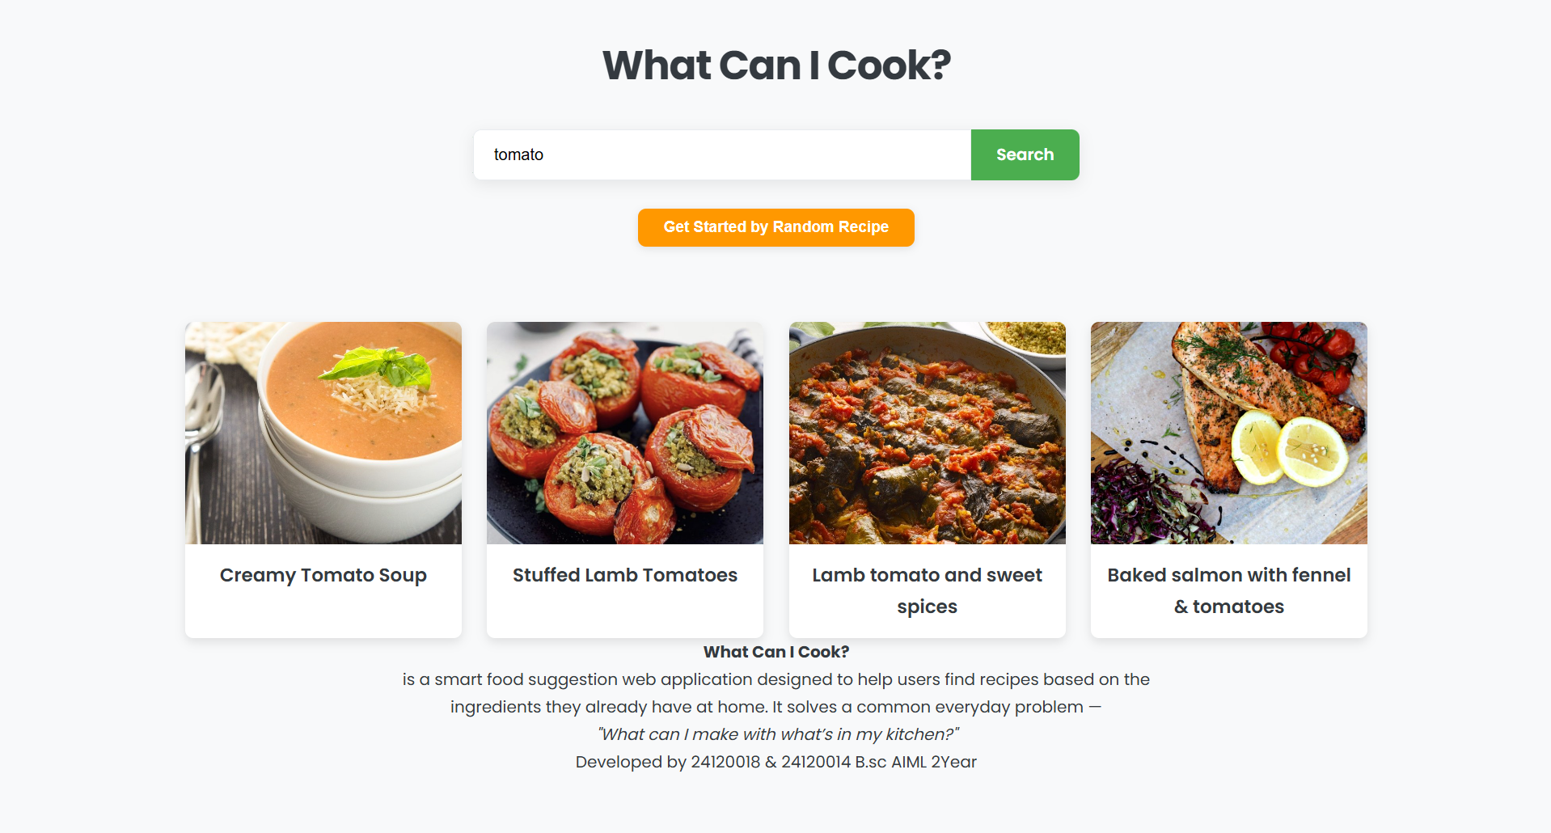
Our Solution: The App
A Smart Web Application
"What Can I Cook?" is a smart web application designed to help users find recipes based on the ingredients they already have at home.
It solves a common, everyday problem by providing instant inspiration and reducing food waste.

Slide 4
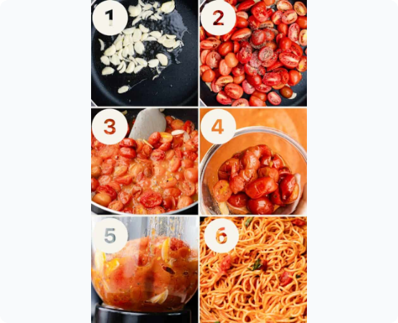
Feature: Search by Ingredient
Find Recipes Instantly
•
The primary feature allows users to input one or more ingredients (e.g., 'tomato').
•
The application immediately searches its database.
•
A visual gallery of matching recipes is returned to the user, ready to browse.

Slide 5





User-Friendly Interface
Visual Grid
Clear Visuals
Responsive Design
Recipes are displayed in a clean, easy-to-browse card layout.
High-quality images help users decide on a recipe at a glance.
The application works perfectly on both desktop and mobile devices.

Slide 6
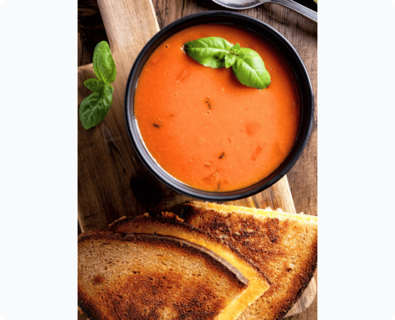
Feature: All The Details
Complete Recipe Info
Clicking any recipe card opens a detailed modal with all the information needed to start cooking.
•
Category (e.g., Starter)
•
Complete Ingredient List
•
Step-by-Step Instructions
•
Links to Video or Original Source

Slide 7






Tools & Technologies Used
Flask (Python)
HTML / CSS
Recipe API
A powerful backend framework for managing all server-side logic and application routing.
The building blocks for creating the clean, responsive, and user-friendly frontend interface.
Used to fetch real-time, dynamic recipe data, including ingredients and instructions, based on user inputs.

Slide 8
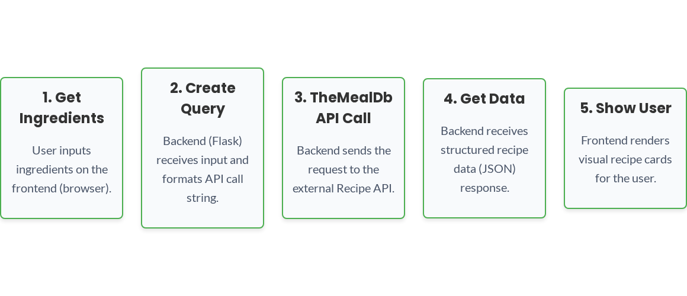
System Flowchart: Recipe Generation

Slide 9
Why This Project is Unique
Unique, Useful & Smart: It combines practical, everyday utility with an engaging and visually smart user experience.
Great for Everyone: The project is an ideal learning tool for beginners in programming, demonstrating key web concepts.
Everyday Helper: It provides a genuine solution that is helpful for users in their daily life, reducing food waste and inspiring new ideas.

Slide 10
Future Implementations
User Accounts: To allow users to save their favorite recipes and build a personal digital cookbook.
Pantry Tracker: A feature to let users save their current ingredients for even smarter, more accurate suggestions.
Meal Planning: Automatically generate weekly meal plans and create shopping lists for missing items.
Native Mobile App: Develop a dedicated, fast, and convenient application for iOS and Android devices.

Slide 11

Thank You
Questions?

